Slide 1


Slide 2

Our first event this year was a joined effort between Ladies that UX Amsterdam & RANDSTAD UX that was hosted by PwC Experience Center in Amsterdam.
The Theme was Design for Good and the Topics, Ethics & AI. We had a four-member panel of experts in this interactive discussion.
77 People came to the live event and we had hundreds tune in online.

Slide 3
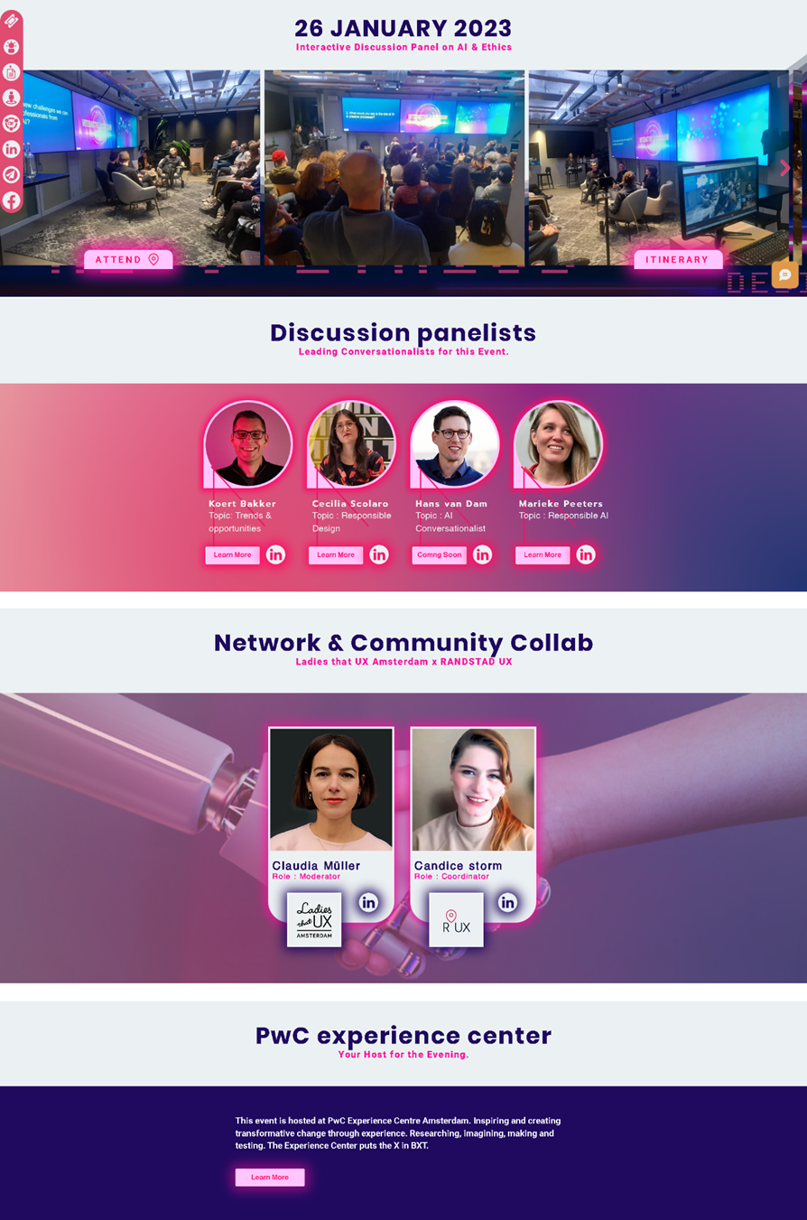
Ladies that UX Amsterdam and R’UX decided and started planning a collab event in November last year. The company that was supposed to host the January event had some developments which resulted in the news that they were not able to host us 18 days before the event was supposed to happen.
We salvaged it, and found a spontaneous hero in PwC Experience Center in Amsterdam and 14 days before the event received confirmation and started planning this event.
Within the tight timeline we managed to build an event page with itinerary and registration form, and we created a small campaign around it.

Slide 4
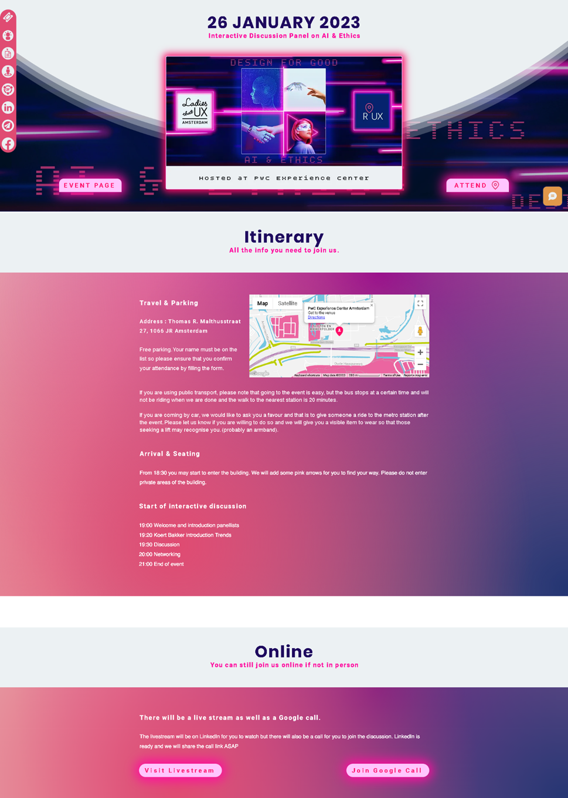
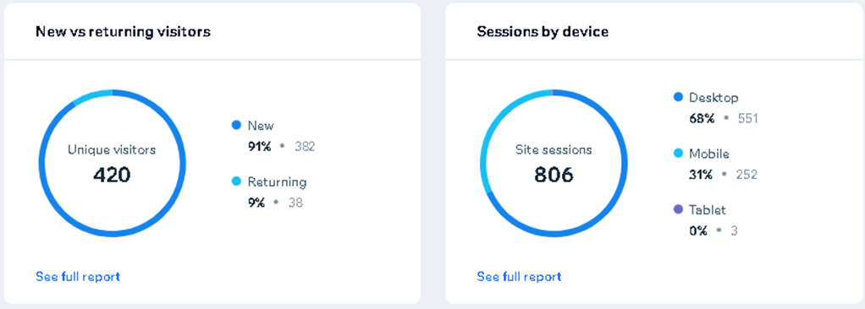
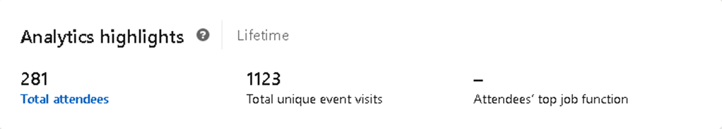
Both the content on LinkedIn and om the platform performed very well.
R’UX Event Portal
LinkedIn Event

Slide 5
Aside from the LinkedIn event and the Event Portal, we also created several social media posts, and we are working on an article on AI & Ethics, which will feature the event and all the stakeholders. The social media posts were intended to create excitement for the event on a light hearted note because of the typical January blues. To do so we created some rhymes and played with a type of countdown on D day. On Monday, Candice met Koert & Sebastian at the Experience center and recorded some short clips, which were used for the first teaser on Tuesday.

Slide 6

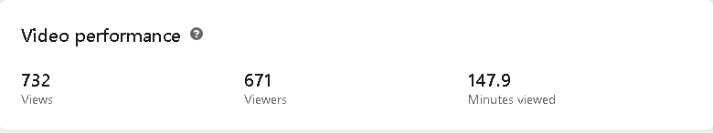
Tuesday the 24th
What did I do today? I went to #pwc Experience Center here in Amsterdam, to prepare for the event this Thursday where RANDSTAD UX teams up with Ladies that UX Amsterdam for our event Design for Good : AI & Ethics. Practicing my video editing skills and with a laptop that took a fall and now does not function all that well, I made this short clip of what we are up to. #Randstad #UX #RandstadUX #InteractiveDiscussion
View Post

Slide 7
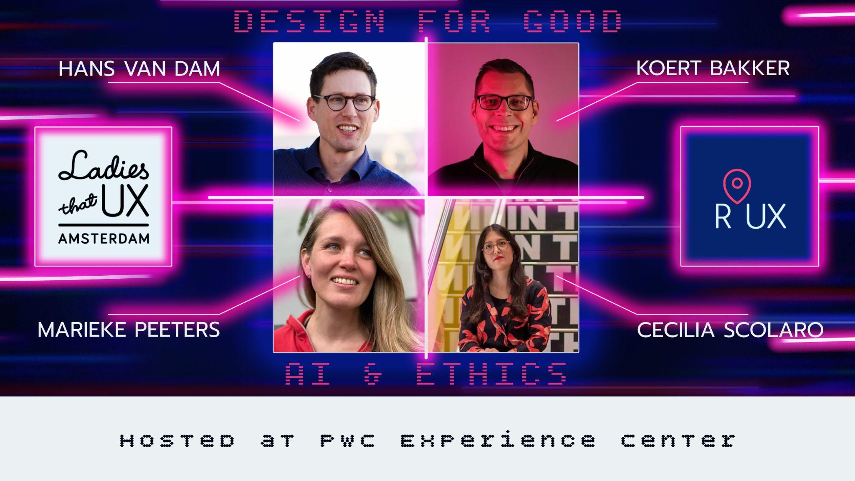
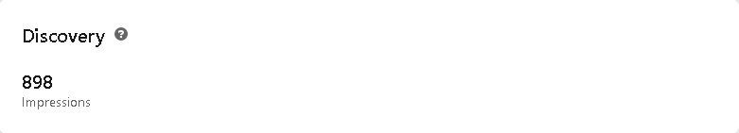
Wednesday the 25th
Meet the Panel Members of this months event where we teamed up with Ladies that UX Amsterdam to create this interactive discussion on the topics of AI & Ethics with the theme Design for Good. Hans van Dam : AI Conversationalist Koert Bakker : Trends & Opportunities Marieke Peeters : Responsible AI Cecilia Scolaro : Responsible Design #Randstad #UX #RandstadUX #InteractiveDiscussion #professionalEvent #panel
View Post

Slide 8
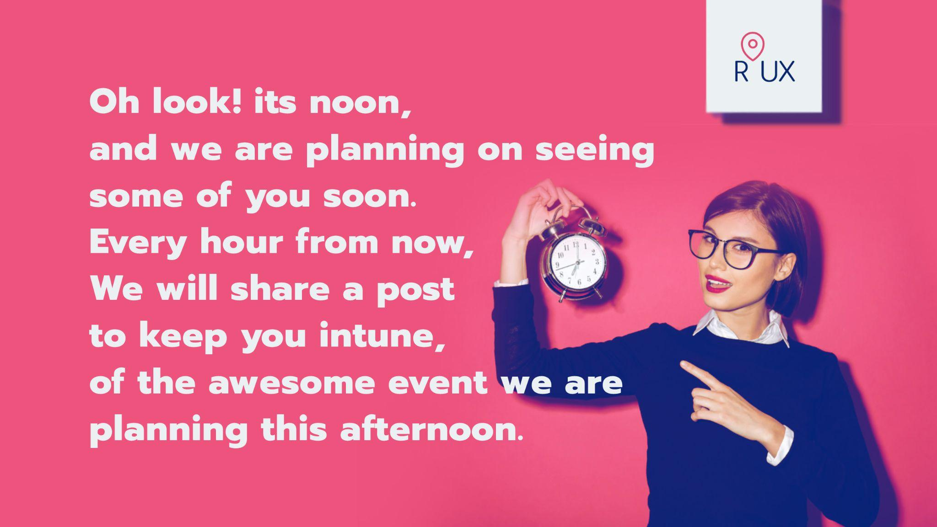
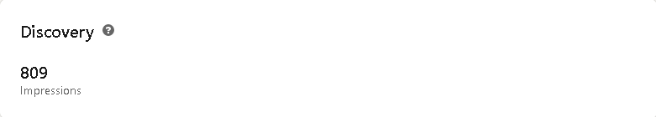
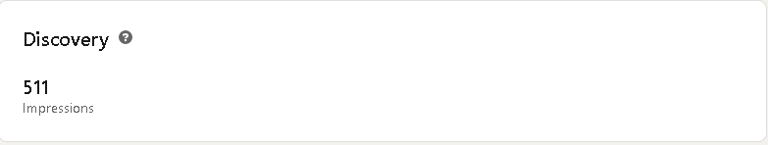
Thursday the 26th : 12:00 PM
Oh look! its noon, and we're planning on seeing some of you soon. Every hour from now, we will share a post to keep you in tune, of the awesome event we're planning this afternoon. #randstad #ux #randstadux #ladiesthatuxamsterdam #pwc
View Post

Slide 9

Thursday the 26th : 1:00 PM
The theme is about the one thing we all know we should, and that is to Design for Good. Central to that is Ethics at its root, which gets quite tricky in the AI neighbourhood. #randstad #ux #randstadux #ladiesthatuxamsterdam #pwc
View Post

Slide 10

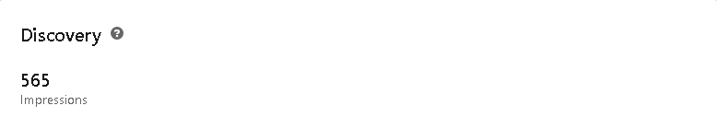
Thursday the 26th : 2:00 PM
aaaand now it is two, and I'm thinking pink & blue. Ladies that UX & RANDSTAD UX both have these two colours in our branding, and to me these two colours are outstanding. For today's event we teamed up and joined forces, which is an excellent example of our discourses. #Randstad #UX #RandstadUX #event #LadiesThatUX #Amsterdam #PwC #ExperienceConsulting
View Post

Slide 11


Thursday the 26th : 3:00 PM
Oh look its three Let's talk about what makes me happy, three letters P w C #Randstad #UX #RandstadUX #event #LadiesThatUX #Amsterdam #PwC #ExperienceConsulting
View Post

Slide 12
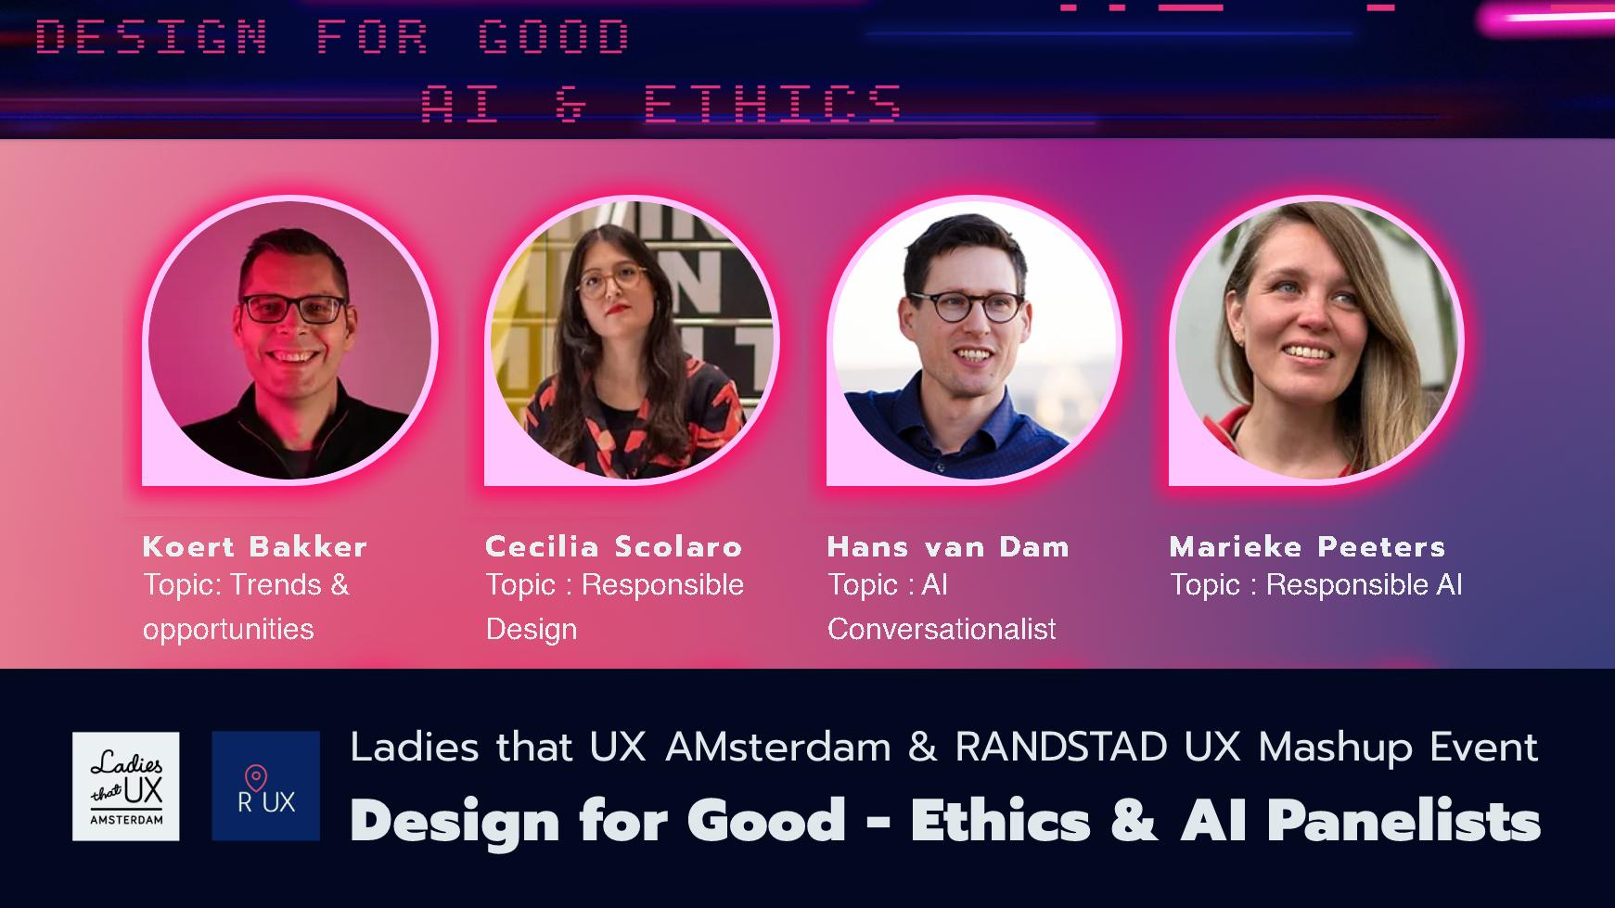
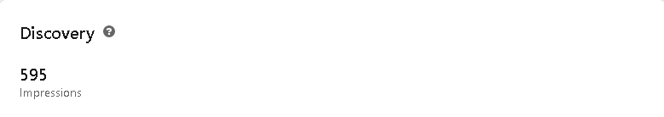
Thursday the 26th : 4:00 PM
Finally its four, time to have a sneak peek at the panel before, a taste of what's in store. Hans van Dam : AI Conversationalist Koert Bakker : Trends & Opportunities Marieke Peeters : Responsible AI Cecilia Scolaro : Responsible Design #Randstad #UX #RandstadUX #event #LadiesThatUX #Amsterdam #PwC #ExperienceConsulting *slight mistake when scheduling
View Post

Slide 13

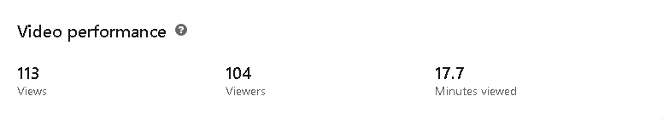
Tuesday the 26th 5:00 PM
Hup hup its five! Time to come alive. A hard days work you did survive, snacks and drinks are sure to revive, Value & impact you're promised to derive, with our free event that will be streamed and live. #Randstad #UX #RandstadUX #event #LadiesThatUX #Amsterdam #PwC #ExperienceConsulting
View Post

Slide 14
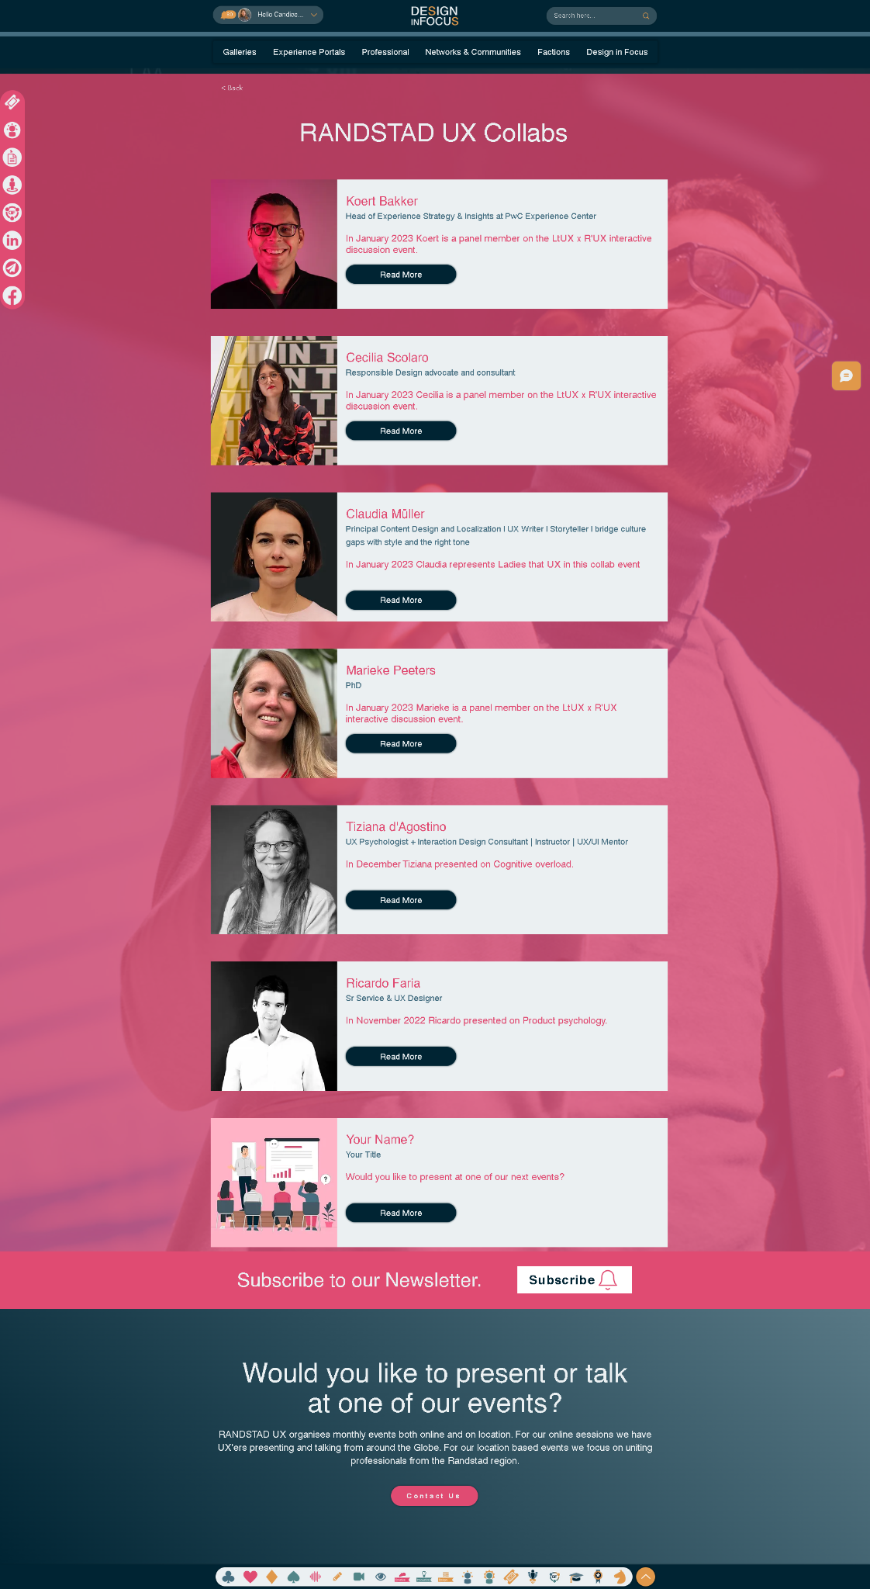
We have a list of collaborators for those who would like to learn more about the stakeholders and also to enable those who partake to be more discoverable online. We added a page for each panelist except for Hans van Dam as well as one for Claudia Muller and Ladies that UX.
View List

Slide 15

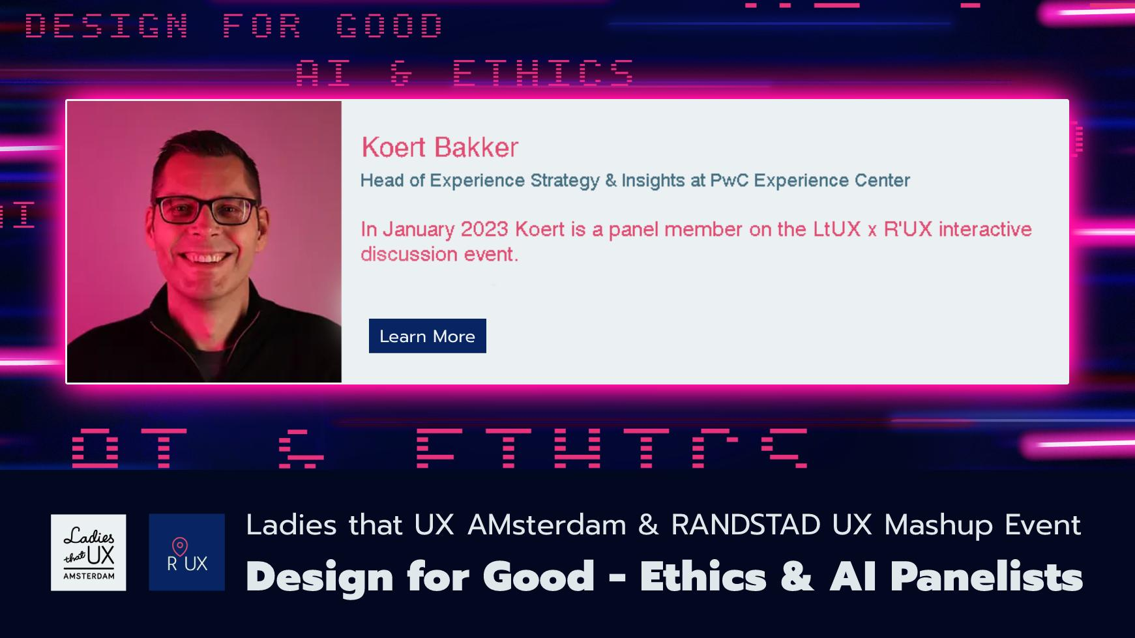


View
View
View
View

Slide 16
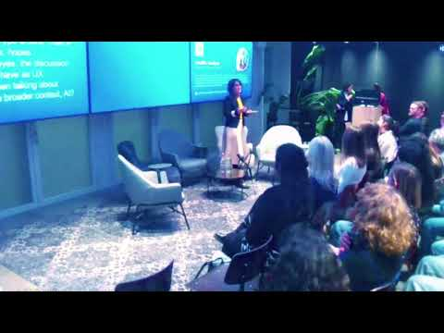
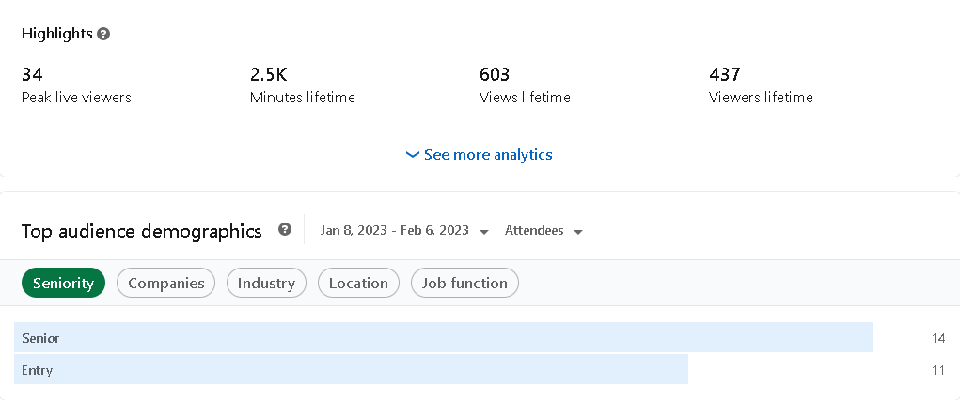
Livestream & Recording
The livestream was a bit more disappointing due to technical failures and a few other challenges, but received warm and complimentary feedback from those who reacted. In the recording there is a 6 minute sound interruption.
View Livestream
View Recording

Slide 17
Given the 18-day timeframe and last-minute action, and although parts of this event could have been designed and executed better, all in all it was a great success. There has been many requests for an extension or continuation of the event and we are in if you are. If there is a next time, we will have experience which means it will be even better.

Slide 18
THANK YOU VERY MUCH FOR YOUR SUPPORT. RANDSTAD UX is a Flagship Network for Design in Focus. Design in Focus awards badges to those who sponsor us or our sub organisations. Koert Bakker & Co from PwC Experience Center Amsterdam, you have received a Supporting Shoulder Badge of honour for sponsoring drinks and food and for hosting the event.
See More

Slide 19
